Slide 1
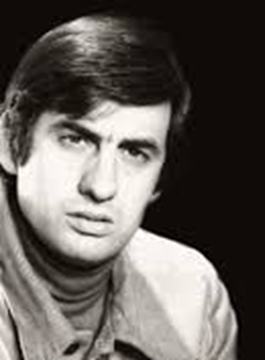
Stanislav Stratiev
Erasmus+ project “MIND your health“
Made by Selin Shaban, 11th grade, Vazrazhdane Secondary School- RUSE,BULGARIA

Slide 2
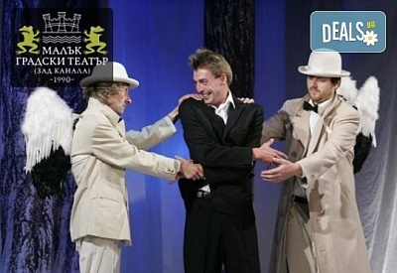
Who is Stanislav Stratiev?
Stanislav Stratiev is a Bulgarian writer and playwright. Till this day his work is played on stage and is loved, and appreciated by audiences.

Slide 3
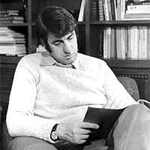
Awards won by the author
Throughout his life, the author has won 12 different awards. Some of them are “Chudomir”, the Annual Union of Bulgarian Writers Award, “Askeer”, “Golden chain”, “Sofia” Award for Literature and Theatre.

Slide 4
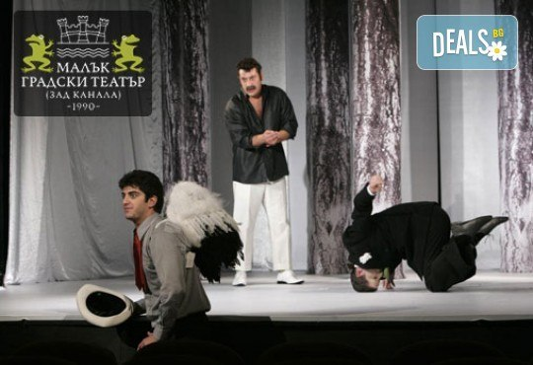
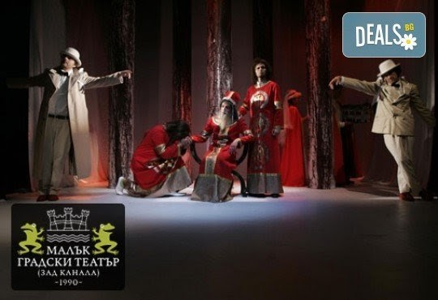
As thought in school
11th graders are thought about the author and his creation “Balkan Syndrome”. It talks about the Balkan culture and their habits.

Slide 5
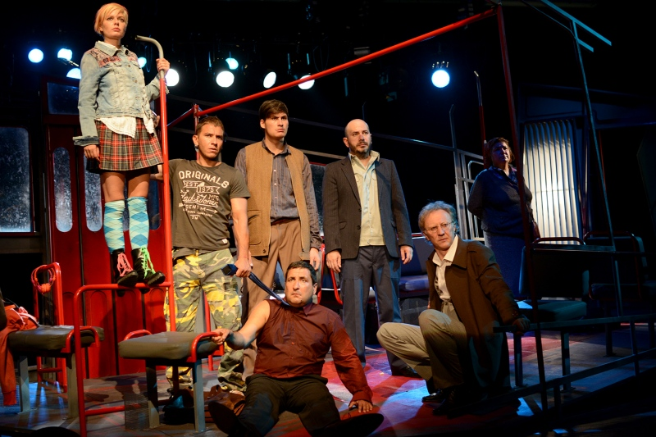
Facts about the author
His work is translated in most European and world languages.
Stratiev published book in Russian called “Skazka”.
The play “Reis” shown in Paris and the French fell in love in the play.

Slide 6
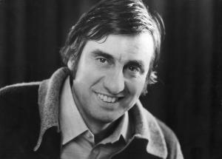
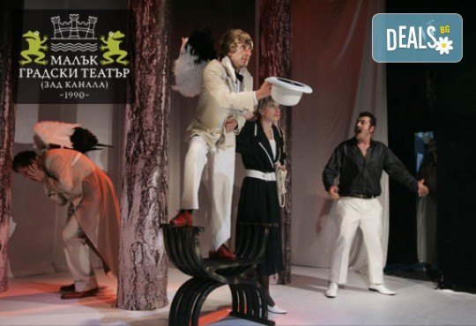
Author’s words
“Ask for your life. Don't let others live it for you. To think for you. To decide for you. To choose for you. To tell you who to love today and who to hate tomorrow.”

Slide 7
Thank you for your attention and Happy Holidays!

