Slide 1
Christmas in Bulgaria in the past and present
Erasmus+ project “MIND your health“
Presentation by: Preslav Ivanov from 11th grade
Vazrazhdane Secondary School – Ruse, Bulgaria

Slide 2
Christmas (also called Bojik or Bojich) is one of the biggest christian holidays. On this day we cepebrate the birth of Jesus Christ.
This holiday has numerous traditions which are passed from one generation to another. Some of them are no longer observed, but the others are still celebrated.

Slide 3
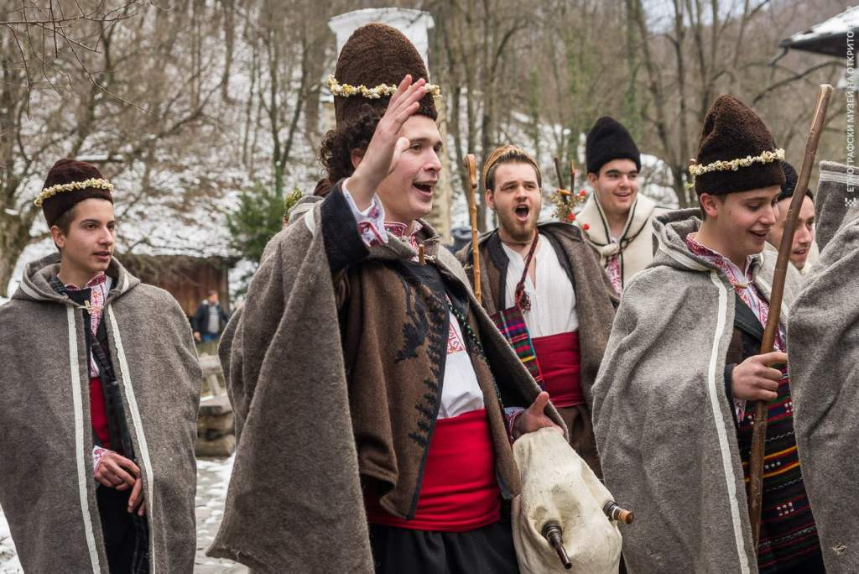
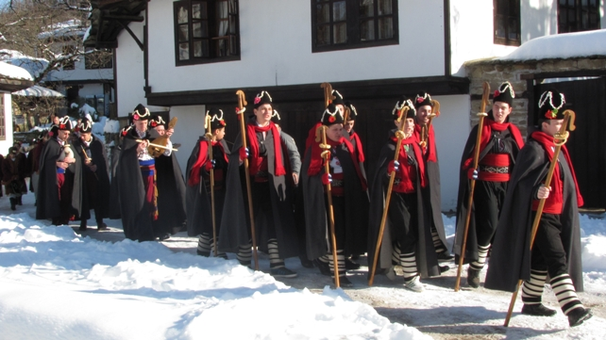
CAROLING
Caroling is one of our Bulgarian Christmas traditions. On Christmas Eve a group of young men go from house to house to sing carols. They are dressed in a traditional holiday outfit with a hat covered with ornaments.

Slide 4
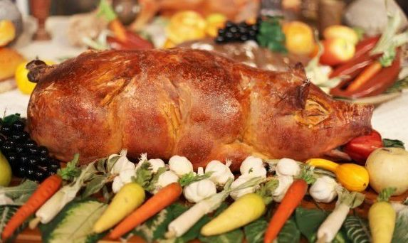
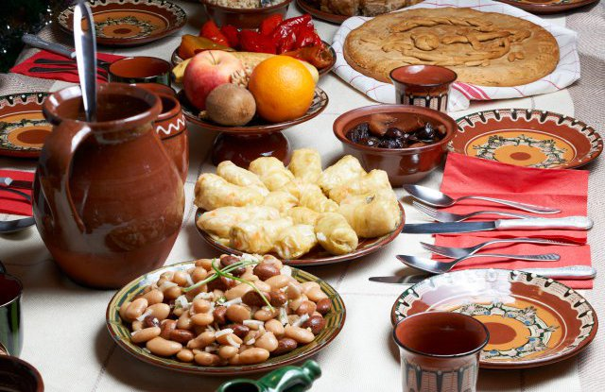
CHRISTMAS TABLE
The Christmas table is always covered with an odd number of lean meals. There is christmas bread, beans, cooked wheat, cabbage and vine sarmi, dried fruit, banitsa and pumpkin pastry.
The old Bulgarian tradition says that on every 25th of December (Christmas day) the special fattened pig has to be slaughtered and cooked for the Christmas table.

Slide 5
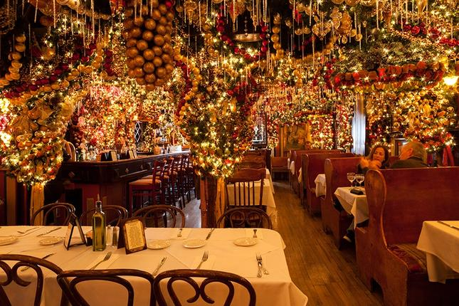
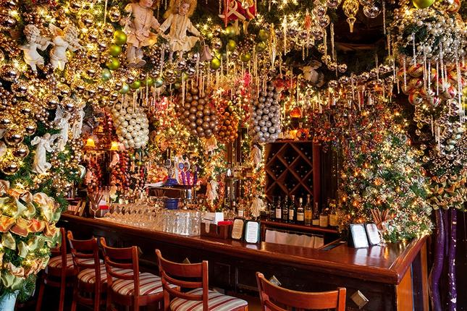
TRADITIONS NOWADAYS
Every family can celebrate outside their homes, Some families celebrate in restaurants or visit their relatives as guests. You can also attend the city center's attractions to take photos and the Christmas shopping centre.

Slide 6
Christmas in my city Ruse

