Slide 1
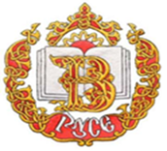
Bulgarian symbols
Prepared by Ivanela Ivanova, XI grade
Vazrazhdane Secondary School Ruse, Bulgaria

Slide 2
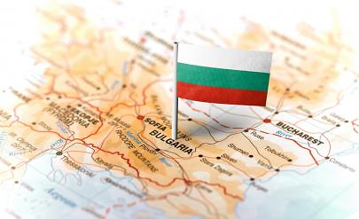
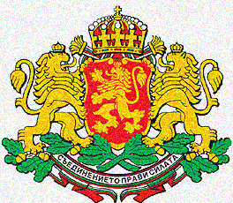
Bulgaria – national symbols
The national symbols of the Republic of Bulgaria are Flag,Coat of arms and Anthem.

Slide 3
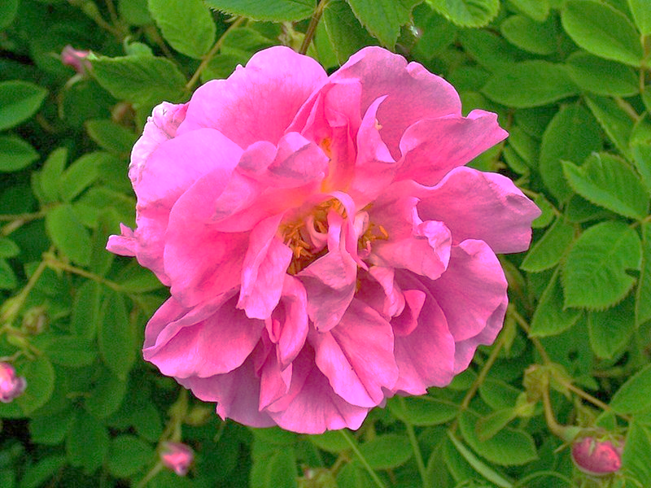
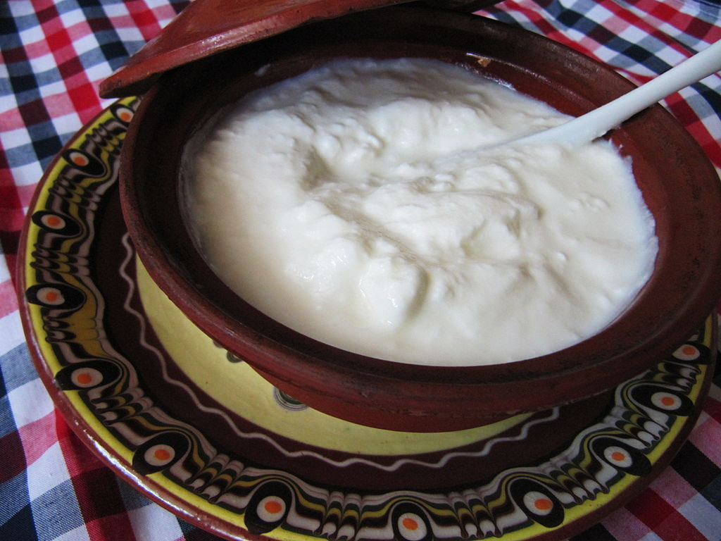
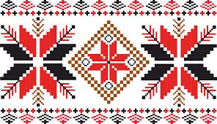
Our image before the world
In addition to the national symbols that distinguish us from other countries, bulgarians have unique symbols that build the image of Bulgaria to the world. These are:
bulgarian yogurt;
Rosa damascena;
bulgarian embroideries.

Slide 4
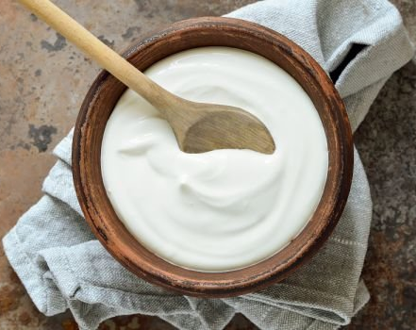
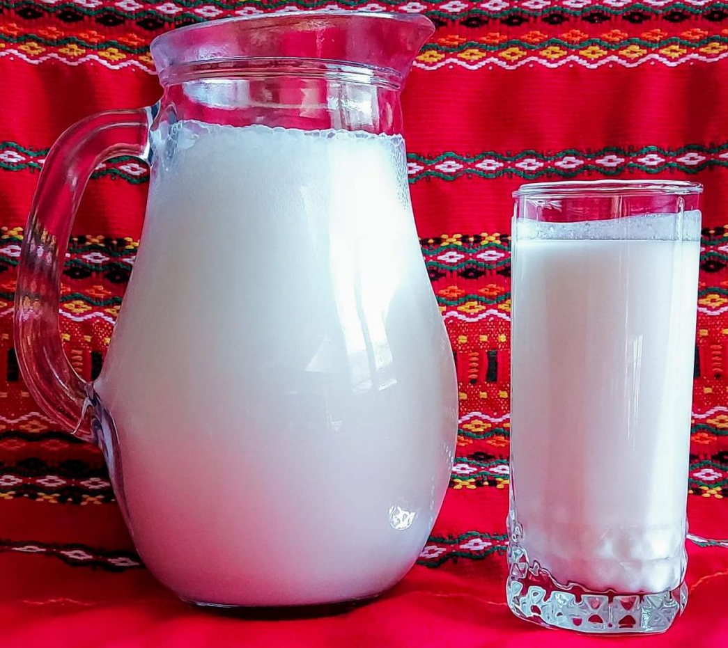
Bulgarian Yogurt
bulgarian yogurt is produced under the obligatory influence of two bacteria – lactobacillus bulgaricus and streptococcus thermophilus. The first bacterium is acidic and the second is sweet;
The acid grows only in the bulgarian latitudes;
This makes it one of our national symbols and the reason for the incredible quality of yogurt .
bulgarian yogurt is an important part of human life and dishes.

Slide 5
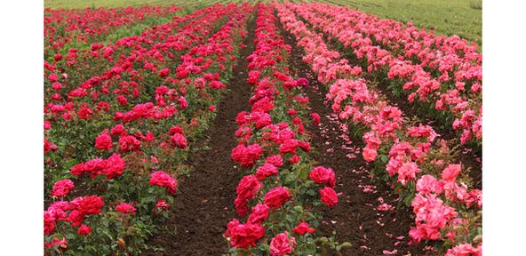
Rosa damascena
Damask rose, or oil-bearing rose, is the greatest wealth of the Kazanlak region. It was brought to the bulgarian lands from Asia;
Today it is one of the symbols of Bulgaria.
Under the influence of the unique climatic and soil conditions,the rose Damascena has developed as a separate species,which differs from the roses in other countries.
Damask rose gets the name “Kazanlak” oil-bearing rose and the area, where it is grown is now called “The valley of roses”.

Slide 6
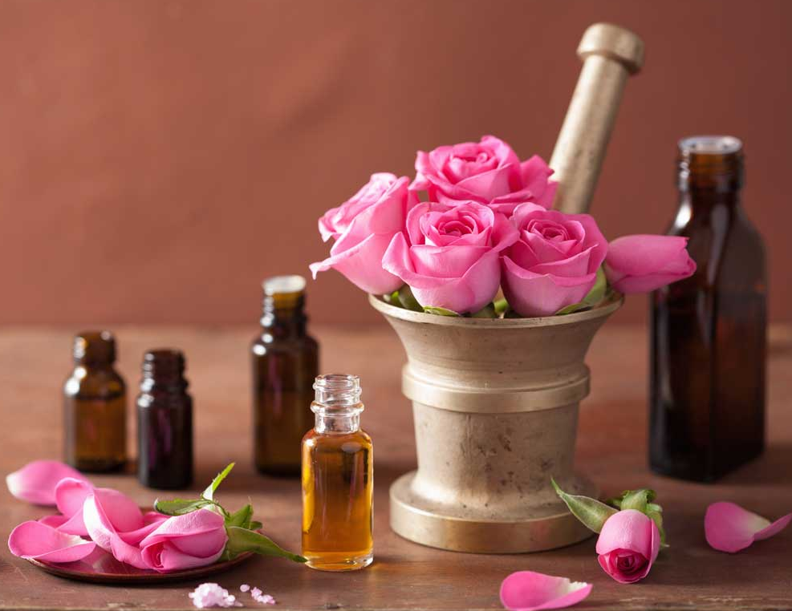
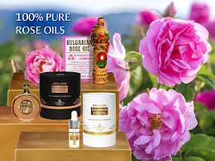
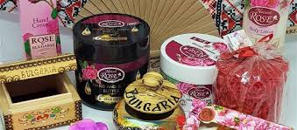
Bulgarian rose - products
Rose oil, is produced from oil-bearing rose, which is used to make many products in the aesthetic and food spheres;
Rose oil and its products are a typical souvenir that everyone, who visits Bulgaria, buys.
The rose – a symbol of beauty and a healing spring of youth!

Slide 7
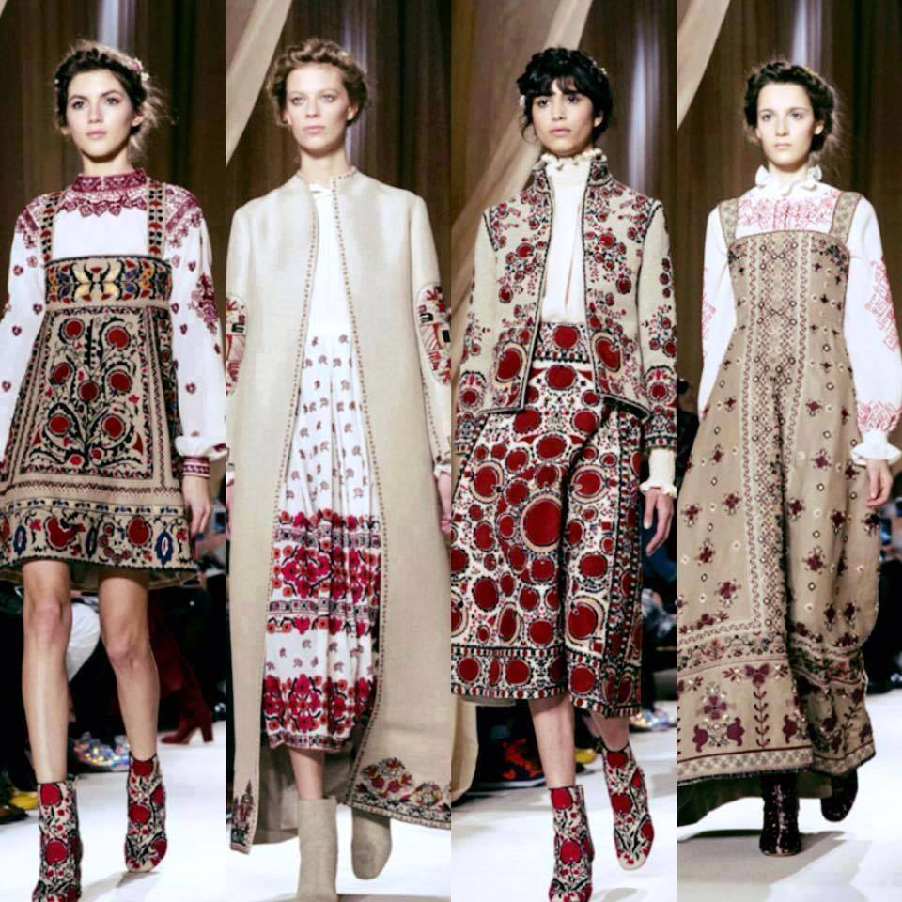
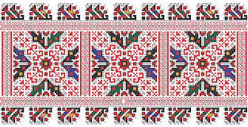
Bulgarian embroideries
Bulgarian embroidery, which is used in traditional bulgarian costumes, is one of our most valuable cultural merits and achievements;
Many different elements are used in embroidery;
Nowadays, bulgarian embroideries are increasingly entering the fashion trends and are used by world brands.

