Slide 1
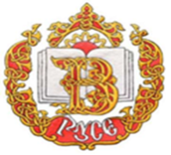
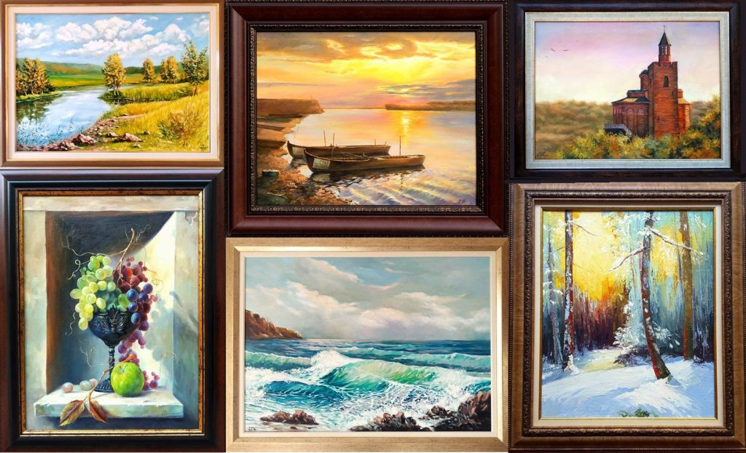
Bulgarian painters whose paintings appear in Bulgarian literature student’s books
Simona Petkova, XI grade
Vazrazhdane Secondary School- Ruse, Bulgaria
Erasmus+ project “MIND your health“

Slide 2
Vladimir Dimitrov- The Master
Vladimir Dimitrov-The Master (1882-1960) is a Bulgarian painter, one of the biggest names in Bulgarian painting. He shines in the portrait and landscape genre and household composition.

Slide 3
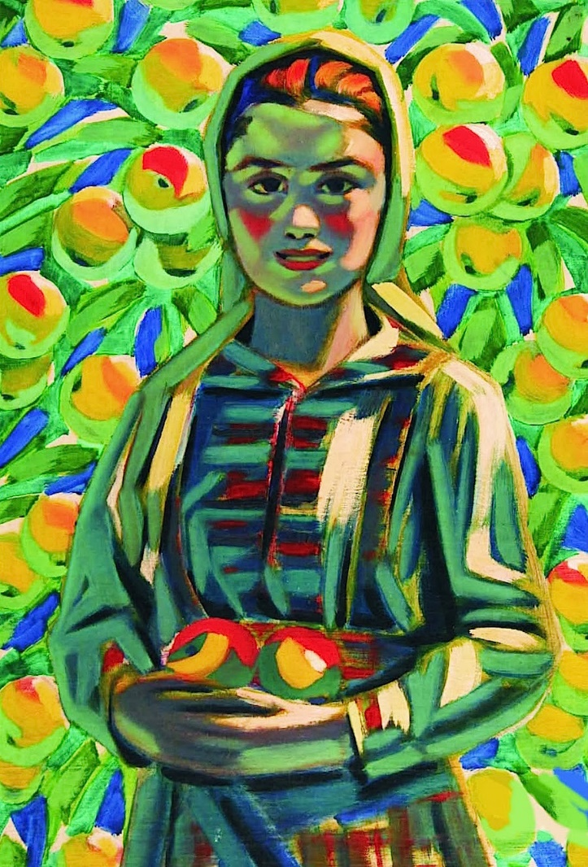
Paintings

Slide 4
Zlatyo Boyagiev
Zlatyo Boyajiev (1903-1976) is a Bulgarian artist famous with his portraits and landscapes. In 1951 his right side is paralyzed and starts painting with his left hand.

Slide 5
Paintings

Slide 6
Ivan Markvichka
Ivan Markvichka (1856-1938) is a Bulgarian painter with Czech origins. He is an important figure in the Bulgarian painting and the folk genre.

Slide 7
Paintings

Slide 8
My paintings

Slide 9
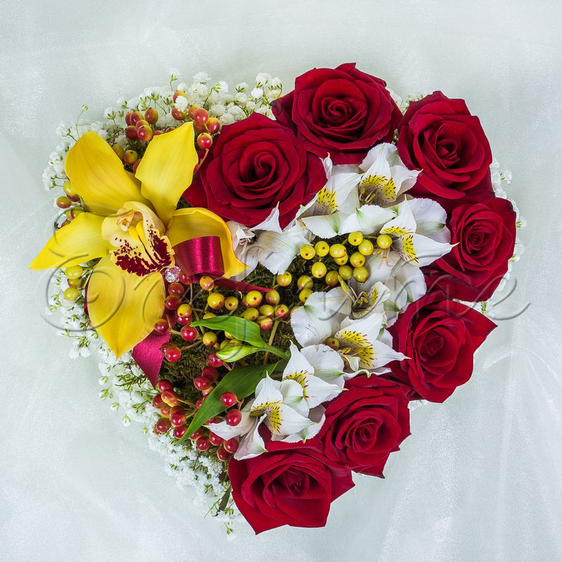
Thank you for your attention!

